Slide 1
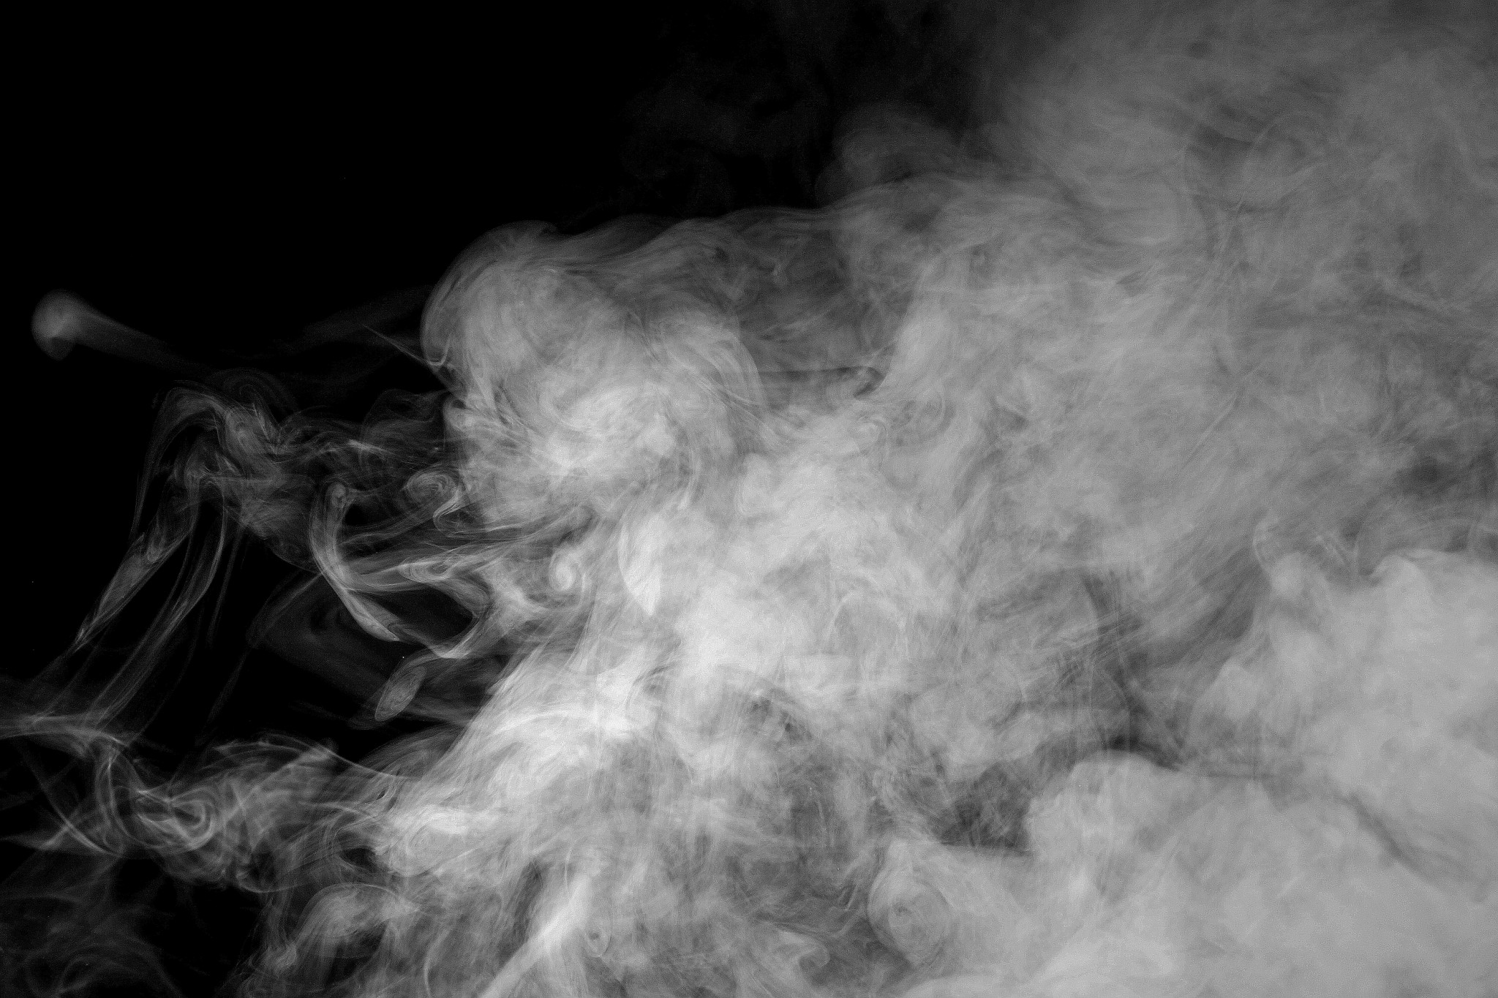
Smoke Detector Risk Model

Slide 2
City of New Orleans + Enigma
public/private collaboration
focused on identifying New Orleans blocks least likely to have smoke detectors and most likely to have a fire
use this data to prioritize fire department smoke detector installation program

Slide 3
Risk Model
overall_risk = (smoke_alarm_risk + (population_risk * 0.34 + home_fire_risk * 0.66)) / 2
smoke_alarm_risk = Random Forest + American Household Survey responses to the question:
Is there a working smoke detector in your household?
population_risk = <5 years of age OR >65 years of age
home_fire_risk = residential fires per capita

Slide 4
Problem
population_risk = <5 years of age OR >65 years of age
although people under the age of 5 and over the age of 65 are a higher risk category, this eliminates other high risk categories, such as disability status
a 40 year old person who is paraplegic would not be considered “high risk” in this calculation

Slide 5
Solution
overall_risk = (smoke_alarm_risk + (population_risk * 0.25 + home_fire_risk * 0.50 + disability_risk * 0.25)) / 2
disability_risk = number of disabled people/population; calculated at the Census Tract level
disability status comes from the American Community Survey
https://public.tableau.com/views/SmokeDetectorRiskModel/MapChange?:embed=y&:display_count=yes

Slide 6
Application
our group has been working with the City of Houston Fire Chief Sam Peña to use this model to more appropriately target at-risk citizens in the City of Houston
through the Mayor’s Office of People with Disability and the Houston Fire Department, we will share this revised prioritization with Enigma and the City of New Orleans

Slide 7
Our Team
Ahmad Razi - Student
Avinash Chintareddy- Student
Margaret Erlandson - Houston R Users Group
Rayneet Minocha - R Data Analyst
Steven David - City of Houston
Maria Town - Director of Mayor’s Office of People with Disabilities

